Slide 1
Mobile App for Direct Market Access for Farmers
CSE7101- Capstone Project
Review-2
Batch Number:
Under the Supervision of,
Dr. Mohammad Buran Basha
Dr./Mr./Ms./Prof.
Professor / Associate Professor / Assistant Professor
School of Computer Science and Engineering
Presidency University
Roll Number | Student Name
20221CIT0089 | Sappidi Hemanth
20221CIT0090 | Vasikeri Praneeth Sai
20221CIT0063 | Talari Vijay Kumar
Name of the Program: B.TECH
Name of the HoD: Dr. Anandaraj S.P
Name of the Program Project Coordinator: Dr. Sharmasth Vali
Name of the School Project Coordinators: Dr. Sampath A K , Dr. Geetha A

Slide 2
Problem Statement Number: 281
Organization: Ministry of Agriculture and Farmers Welfare
Category (Hardware / Software / Both) :Software
Problem Description:
Farmers often face challenges in accessing markets, leading to lower income due to middlemen. This gap restricts their ability to sell produce at fair prices. Creating a mobile application that connects farmers directly with consumers and retailers. This app include features for listing produce, negotiating prices, and managing transactions, thereby reducing dependence on intermediaries.

Slide 3
Content
Objectives
Background and Related work for title Selection
Analysis of Problem Statement
Innovation or Novel Contributions
Git-hub Link
Timeline of the Project
References

Slide 4
Objectives
To provide farmers a direct digital platform to sell their produce without middlemen.
To allow farmers to easily list crop details and connect with buyers instantly.
To support secure and quick digital payments through UPI or bank transfers.
To integrate simple logistics support so farmers can transport their produce easily.
To offer multi-language and voice-based features for rural accessibility.

Slide 5
Background and Related work
Farmers often earn less due to middlemen, low bargaining power, and lack of real-time price data.
Existing platforms like eNAM (Govt) and AgriBazaar (Private) aim to help but face low adoption because of complex interfaces, limited coverage, and language barriers.
Other apps like Kisan Suvidha and Mandi Trades provide price information but do not support direct farmer-to-buyer transactions.
With the rise of smartphones, UPI payments, and regional language demand, there is a need for a simple, all-in-one mobile app.
The gap lies in building a solution that combines produce listing, buyer-farmer communication, secure payments, logistics, and multilingual support in a single platform.

Slide 6
Analysis of Problem Statement
Technology Stack Components:
1. Frontend:
Flutter (Dart): Cross-platform framework for building Android & iOS apps with a single codebase.
Material Design & Widgets: For responsive, user-friendly UI.
Multi-language Support: Using Flutter localization for regional languages.
2. Backend:
Firebase Cloud Functions (Node.js): Serverless backend to handle business logic.
REST APIs / GraphQL : For structured communication between frontend and backend.
3. Database
Firebase Firestore (NoSQL): Real-time storage for users, produce listings, and transactions.
Cloud Storage: For storing product images (crops/produce photos).

Slide 7
Analysis of Problem Statement (contd...)
4. Authentication & Security
Firebase Authentication: Email/Phone/Google login for farmers & buyers.
JWT (JSON Web Tokens): For secure session handling.
Role-based Access Control: Differentiating farmer and buyer features.
Encryption (HTTPS, SSL): To protect sensitive data.
5. Maps & Location Services
Google Maps API / Mapbox: For GPS tracking, showing nearby buyers/sellers.
Geofencing: To alert farmers of demand within their region.
6. Payment Integration
Razorpay / Paytm / UPI / Stripe: For instant and secure digital payments.
Payment Receipts & History: Stored securely in database for farmer records.

Slide 8
Analysis of Problem Statement (contd...)
7. Notifications & Communication:
Firebase Cloud Messaging (FCM): Push notifications for offers, demand alerts, and payment confirmations.
In-app Chat / Messaging (Firebase Realtime DB): For buyer-farmer communication.
8. Hosting & Deployment:
Firebase Hosting / Google Cloud Platform (GCP): Hosting backend APIs and services.
Play Store & App Store Deployment: For Android and iOS release.
9. Version Control & Collaboration:
GitHub / GitLab: For code management, issue tracking, and collaboration.
CI/CD (GitHub Actions): For automated builds and deployments.
10. Testing & Debugging Tools
Postman: For API testing . Flutter Test / Integration Test: For unit and UI testing.
Firebase Test Lab: For testing app on multiple devices

Slide 9
Analysis of Problem Statement (contd...)
Current Challenges:
Farmers depend on middlemen, leading to reduced income.
Lack of real-time market prices and demand visibility.
No direct and reliable communication channels with buyers.
Difficulty in arranging transport and logistics.
Low digital literacy and language barriers in rural areas.
Needs & Expectations
A centralized mobile app for direct farmer-to-buyer sales.
Simple, multilingual interface for rural accessibility.
Real-time price updates and demand notifications.
Secure digital payments with instant receipts.
Integrated logistics support for transport and delivery.

Slide 10
Analysis of Problem Statement (contd...)
Expected Benefits
Fair prices and higher income for farmers.
Transparency and trust in agricultural trade.
Reduced post-harvest losses with quicker sales.
Empowered farmers contributing to rural economic growth.

Slide 11
Github Link
The Github link provided should have public access permission.
GitHub Link

Slide 12
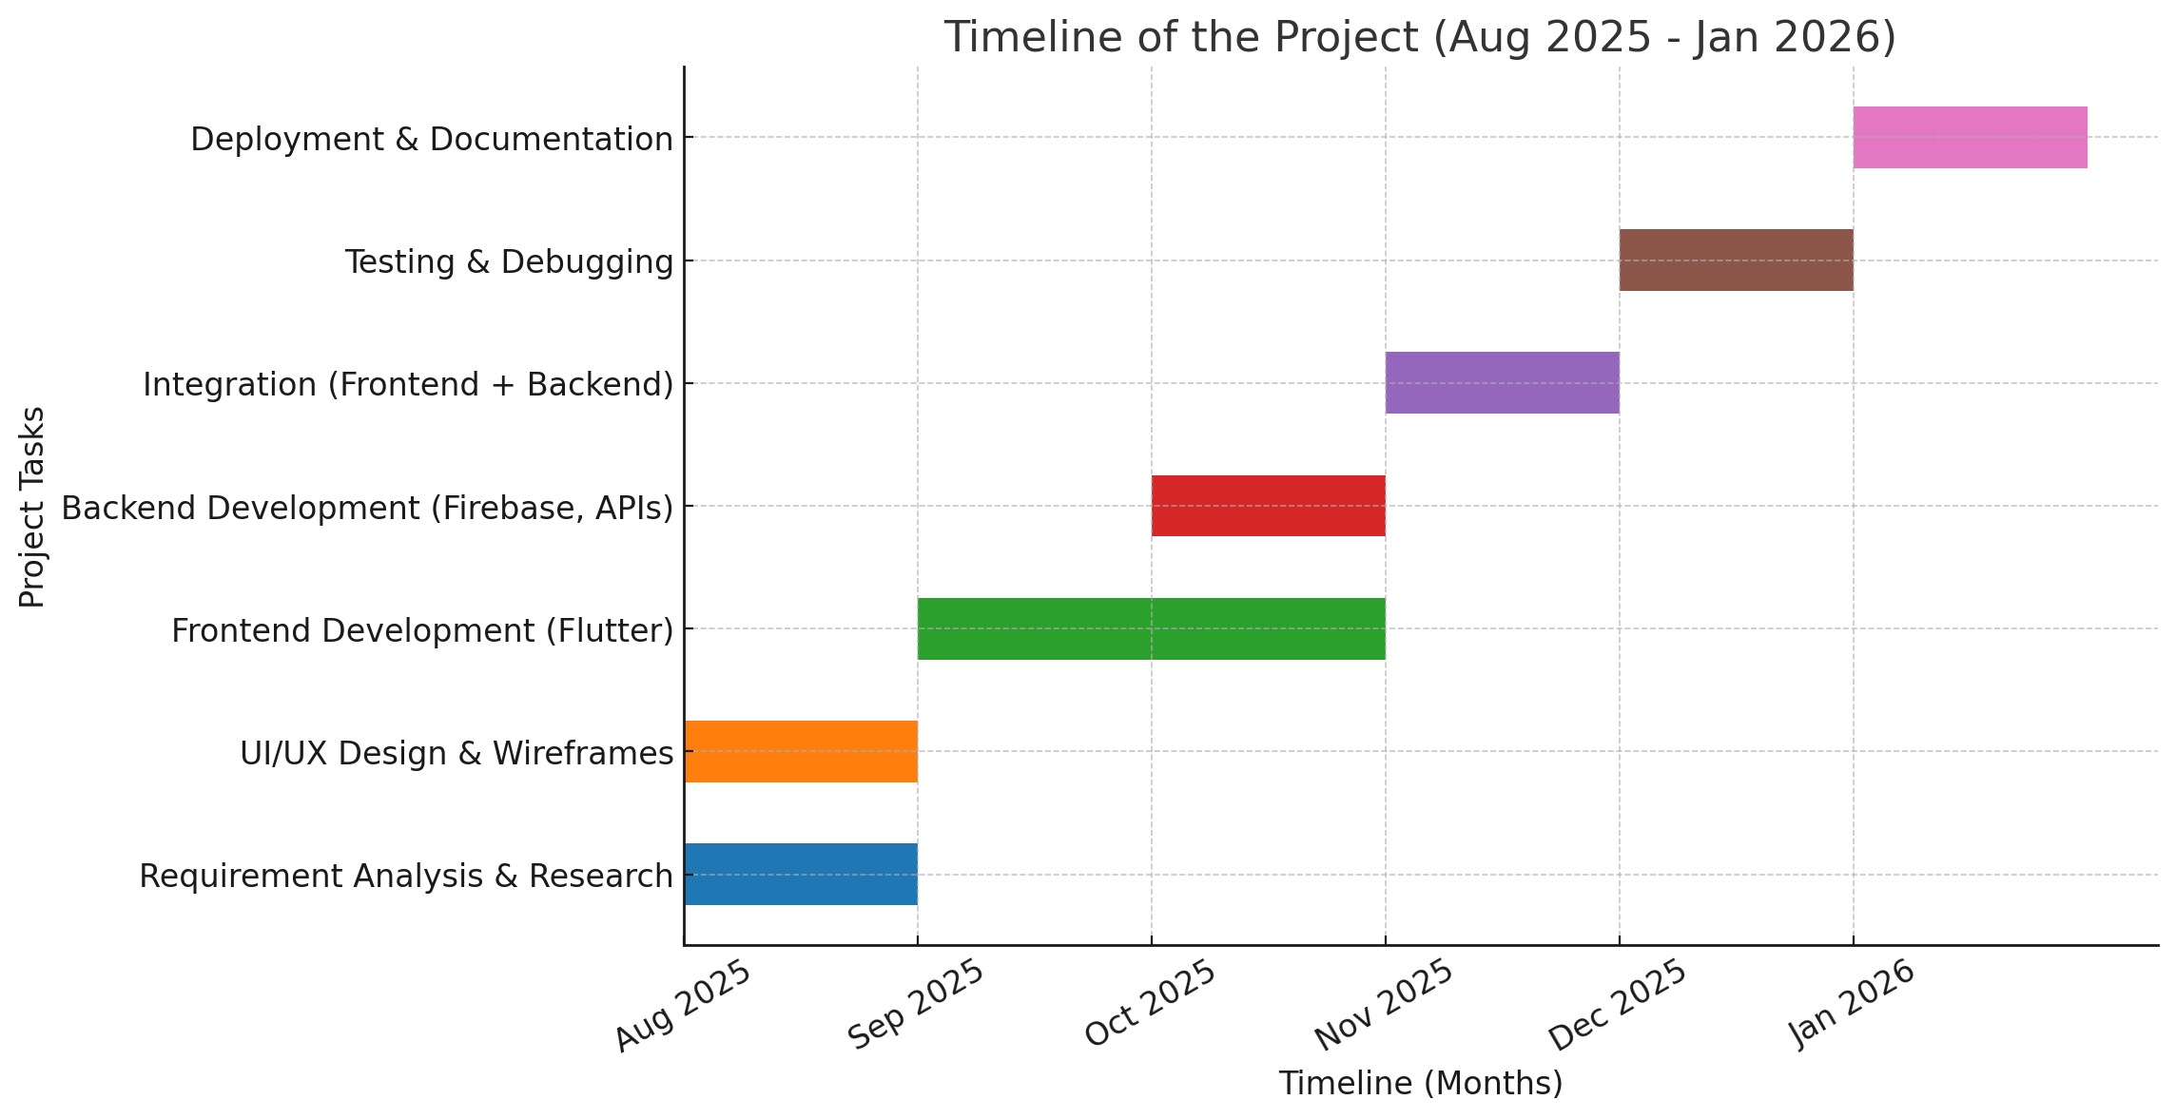
Timeline of the Project (Gantt Chart)

Slide 13
References (IEEE Paper format)
[1] A. Singh, P. Sharma, and R. Kumar, “Digital platforms for agricultural marketing: A review,” IEEE Access, vol. 8, pp. 12345–12356, Jun. 2020.
[2] R. Gupta and M. Jain, “Role of ICT in agricultural development and farmer empowerment,” IEEE Transactions on Emerging Topics in Computing, vol. 9, no. 2, pp. 678–685, Apr. 2021.
[3] Government of India, “eNAM – National Agriculture Market,” Ministry of Agriculture & Farmers’ Welfare. [Online]. Available: https://www.enam.gov.in. [Accessed: Aug. 18, 2025].
[4] AgriBazaar, “Connecting Farmers and Buyers through AgriTech,” [Online]. Available: https://www.agribazaar.com. [Accessed: Aug. 18, 2025].

Slide 14


